Slide 1
Introduction to eXo
the user experience platform-as-a-service company
Benjamin Mestrallet, Founder & CEO
February 2012

Slide 2
Agenda
Who We Are
Mission
Company overview
What Problem We Solve
Consumerization of IT
Defining the UXP and UXPaaS
Our Technology
Cloud-ready portal and UXPaaS: eXo Platform 3.5
Hosted solutions: eXo Cloud Services
Customer and Partner Success
Customer snapshots
Subscriptions, professional services and partner programs

Slide 3
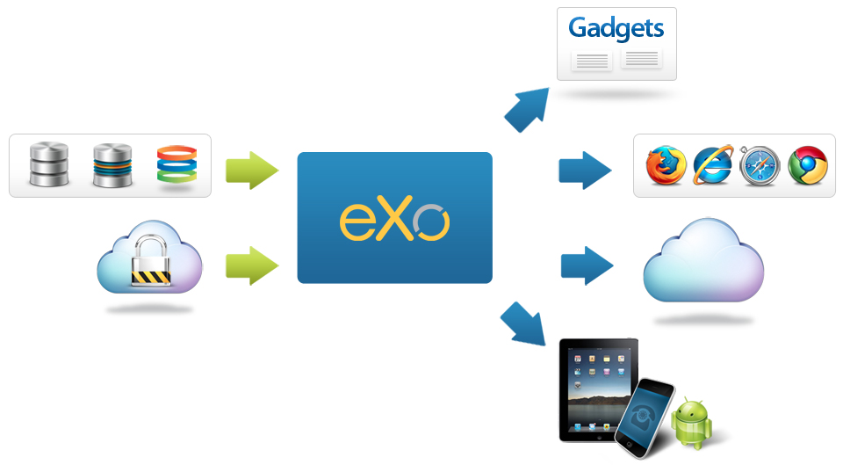
eXo Mission
Empower companies to deliver connected, collaborative user experiences to their employees, customers and developers, that can be securely deployed on-premises, mobile and cloud environments.
Notes:
eXo helps companies connect their employees, customers and developers through social, collaborative and content-driven intranets, websites and dashboards.

Slide 4
Quick Facts
Background
Founded in 2003; venture-backed since 2010
Headquarters: San Francisco (US), France (global)
Our Team
Veterans from JBoss, Red Hat, HP, Oracle, Hyperic, BCG
Low-cost distributed model; 175 employees worldwide (US, France, Ukraine, Vietnam, Tunisia)
What We Offer
Subscription support
Training and professional services
Core Competencies
Long Java history – implemented first portlet spec (JSR-168), led to first customer, US DoD
Open source foundation
Standards support (e.g. CMIS, JCR, portlets, OpenSocial)
Notes:
update

Slide 5








Customers: Private Sector

Slide 6











Customers: Government

Slide 7









Customers: Bank & Insurance

Slide 8












Our Ecosystem: Value-Added Partners

Slide 9












Technology & OEM Partners

Slide 10
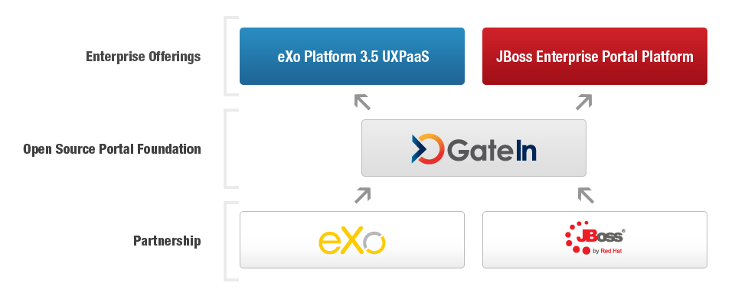
Red Hat Partnership
Notes:
Update diagram

Slide 11
What Problem We Solve
Defining the UXP & UXPaaS

Slide 12
Evolution of the Enterprise Portal
Enterprise Portals: The Foundation for User Interaction
Provide a single, personalized user interface to access applications, information and business processes
Standards-based approach to user management and application integration
Converging Trends
Additional user interaction tools required for new scenarios (WCM, mashups, social software, etc.)
Cloud computing promises cost reductions and improved agility – organizations beginning to plan for and adopt
Focus on user engagement in the consumer web results in new style, functionalities, ease of use – and new expectations in the enterprise

Slide 13
New Requirements
Business Users
Demand for simplicity of Facebook-style interfaces and consumer web features for enterprise tools
Frustration with top-down resource allocation and dependence on IT
Enterprise Developers
Challenges of integrating third party apps with existing infrastructure
Multiple disconnected tools require different user interaction models and code bases
Longer development lifecycle hinders ability to deliver new solutions
IT Organizations
Disconnected silos are difficult to maintain; complex to add new users
End user adoption of third-party SaaS tools introduces new security concerns; loss of centralized control of enterprise information
IT becomes bottleneck to adopting new technology

Slide 14
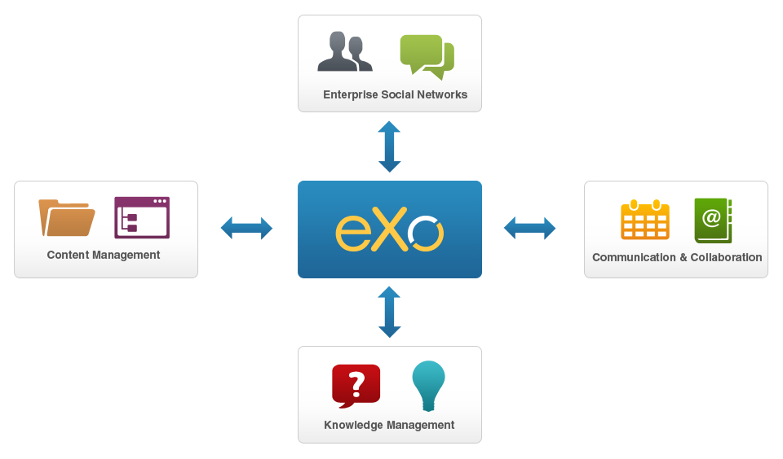
Beyond Portals: Introducing the UXP
A user experience platform (UXP) is a set of user interaction technologies – portal, content and knowledge management, social networks, and collaboration – delivered as a single, fully integrated product.

Slide 15
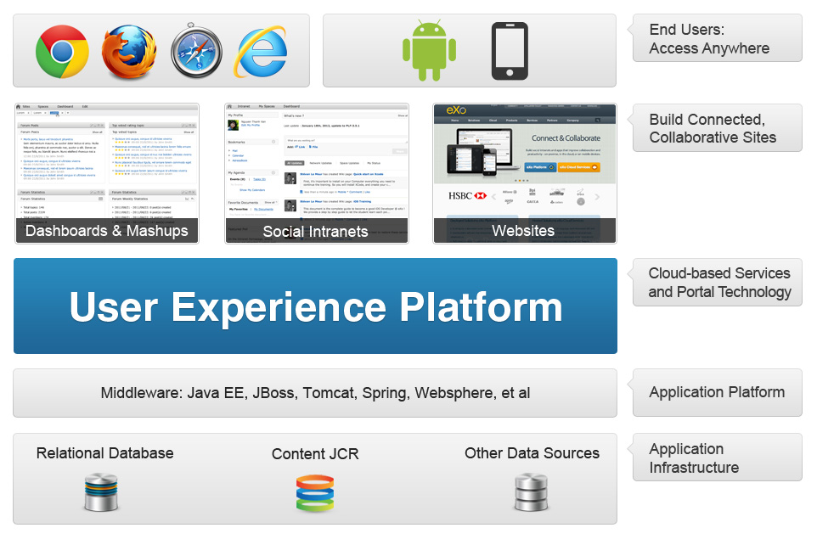
What Can You Create with a UXP?

Slide 16
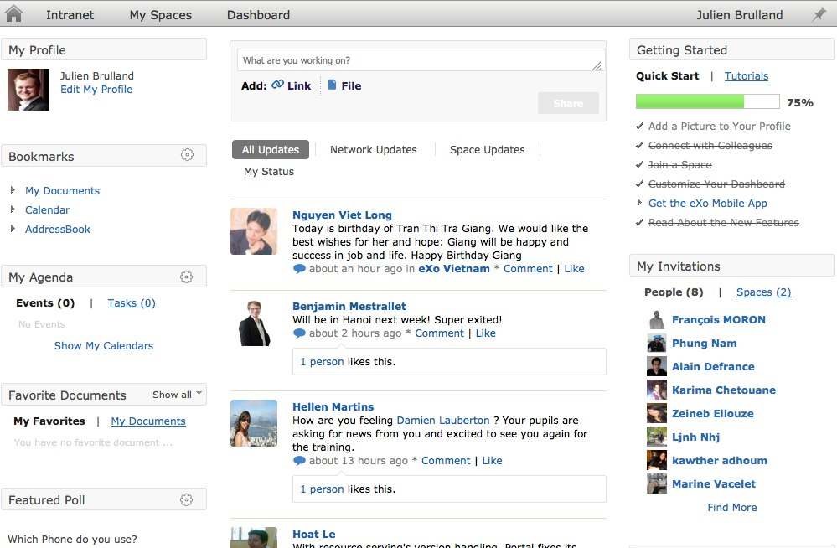
User-Friendly Social Intranets
Notes:
16
A common use case scenario for a UXP is building a social intranet. A secure enterprise intranet starts with a portal foundation, to integrate apps and content in a single dashboard for users; this dashboard view is customized based on what apps, content and information the user has permission to access.
A social intranet goes beyond a traditional portal to deliver a more interactive and productive user experience. Connect users and teams, activity streams, share calendars, documents and other resources, collaborate in group workspaces and much more.
A social intranet goes beyond a traditional portal to deliver a more interactive and productive user experience. Connect users and teams, activity streams, share calendars, documents and other resources, collaborate in group workspaces and much more.

Slide 17
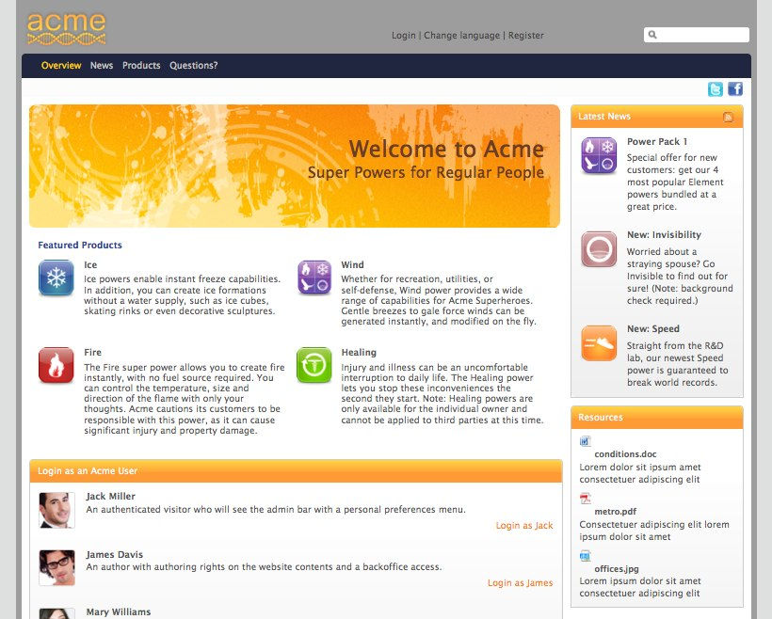
Modern Content-Based Sites
Notes:
17

Slide 18
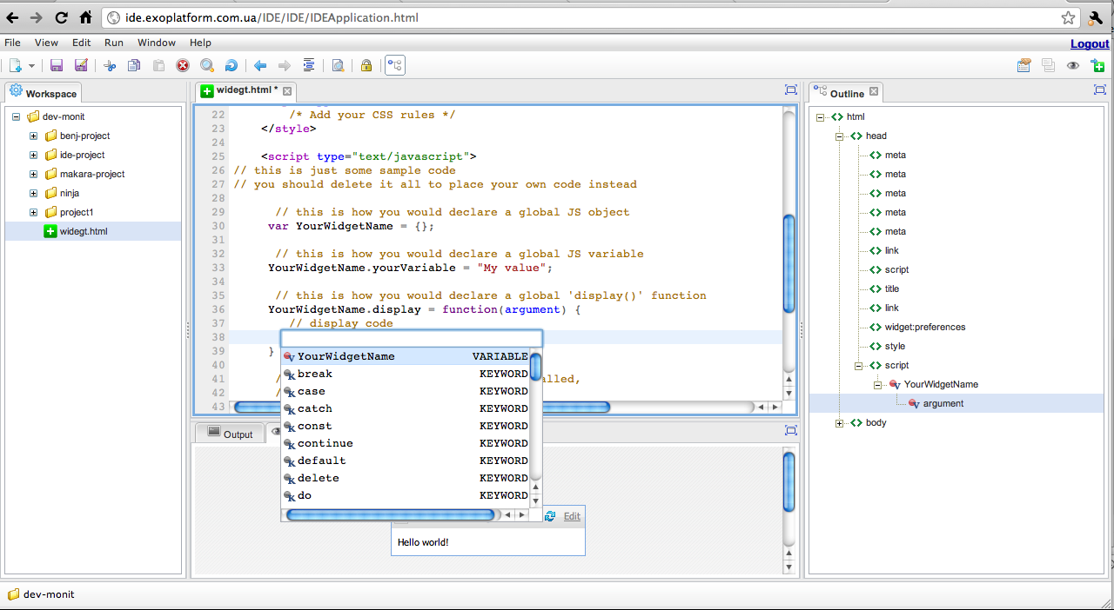
Custom Gadgets & Extensions

Slide 19
Defining the UXP
Integrated
A single set of user interaction technologies for many scenarios and devices
Flexible
Gadget development with built-in IDE; simplifies reuse of existing and third-party apps
Customizable dashboards
Social & Collaborative
Social intranets, customer and partner extranets, transactional websites
Mobile

Slide 20
The UXPaaS: A Cloud-Ready UXP
Cloud-Enabled
Support for multi-tenancy for deployment to public and private clouds
A UXP that can be delivered as a service by cloud providers
Automation & Elasticity
JVM resource self-management – easily scale up or down
Ease of provisioning with little IT administration overhead
Secure
Ensure the isolation and integrity of individual client portals
Ability to integrate with existing client directory systems
Manageable
Centralized & secure for IT management
Elasticity and self-provisioning services
Easily manage and meter use of tenants

Slide 21
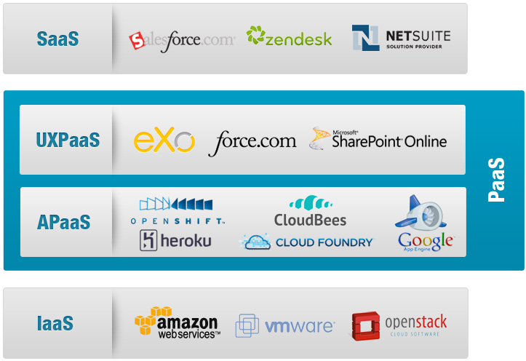
The UXPaaS & The Cloud Market

Slide 22
eXo Platform 3.5
the mobile and cloud-ready portal and user experience platform

Slide 23
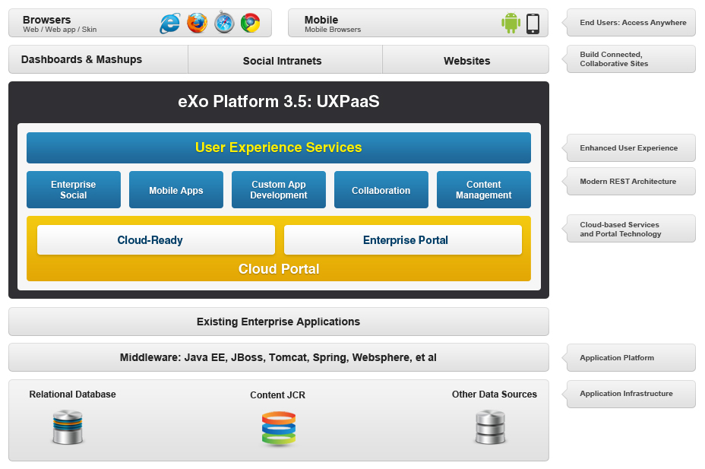
Introducing eXo Platform 3.5 UXPaaS

Slide 24
Features & Benefits
Portal & Content Management Foundation
Securely integrate with an existing user directory
Integrated content management (ECM: WCM, DMS, workflows)
Enterprise Social Networks
Create rich profiles; find and connect with colleagues
Activity streams
Collaboration & Knowledge Management
Collaborate in group workspaces
Built-in productivity tools: wiki, forums, FAQs, calendars, documents…
The Platform Difference
Customize
Extend
Notes:
Details:
- ECM Features:
- Create, edit & publish web content
- Capture, store and manage documents
- Optional BPM and workflow features
- WCM Improvements for 3.5:
- Edit inline (on the front-end) and publish in one click
- SEO: Search Engine Optimization
- New File Explorer Design
Enterprise Social features:
- Create and connect rich user and team profiles
- Follow activity streams of users, teams, applications, processes
- Workspaces for users and groups
- OpenSocial gadgets
-- Improvements in 3.5 include: New Activity Stream Page with Filters, User Directory is simplified, New Space Layout
Collaboration & Knowledge Management features
-- An intranet or extranet that aims to connect a community of users, partners or customers will likely require a forum and/or wiki. eXo Platform 3.5 includes out-of-the-box features to easily add an enterprise wiki, forum, FAQ’s, and Answers to your sites.
-- Enterprise Wiki: Permissions integrated with eXo Platform user management; Social Network Integration ( Activity Stream, Space, …);Pages are stored inside eXo JCR – our centralized content repository; Page Management, search & versionning; Easily add pages: Wysiwyg editor & support for multiple syntaxes
-- Group calendars
Calendars can be shared between users and teams
Improvements to PLF 3.5: Remote Calendar
Integrate 3rd Party Calendar into eXo Calendar
Based on Standard CalDAV, Ical
Apps: Google Calendar, MS Exchange, …
Warning: Read Only
You can view all your calendars in eXo but cannot update them

Slide 25
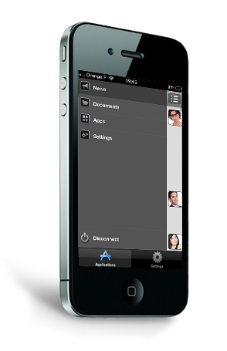
Native Mobile Apps
Native mobile apps for iPhone, iPad and Android give eXo Platform 3.5 users secure access to their intranet dashboards, including documents and custom gadgets.
Notes:
Native Application to Access Intranet Services
Native Application : iOS (iPhone, iPad), Android
Social Network (activities), Documents, Gadgets
Integrates with eXo Platform 3.5 Enterprise Edition
Interesting Blog post « Introducing New Mobile Applications for eXo Platform 3.5 »
Note: We can also build mobile websites with eXo Platform’s content management features
Based on HTML/CSS programming

Slide 26
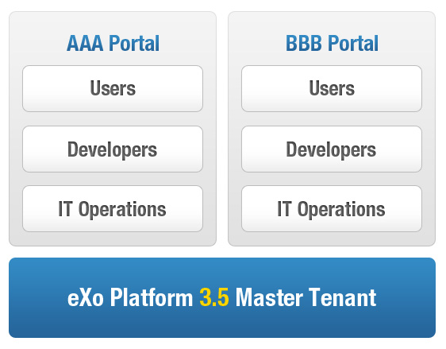
The First Multi-Tenant Portal & UXP
Cloud: Introducing the UXPaaS
Private or public cloud deployments
Elastic solution

Slide 27
Benefits of Cloud Deployments
CLOUD PROVIDER
Cost efficient portal multi-tenancy (JVM level)
One extensible and unified user experience platform to operate across many customers
USERS
Enterprise social and collaboration capabilities
Embed business apps in customized dashboards
Extend your portal by aggregating private / public cloud apps
Smartphone & tablet User Interface
IT OPS
Private/public cloud management and monitoring within a portal
Single UX for all users lowers support costs

Slide 28
eXo Cloud Services
Hosted Solutions

Slide 29
eXo Cloud Services
Build your own cloud with eXo Platform 3.5 UXPaaS
Cloud-enabled infrastructure provides ideal foundation for building a public or private cloud offering
Or connect and collaborate in a hosted solution: eXo Cloud Services
Social intranets
Collaborative development environments

Slide 30
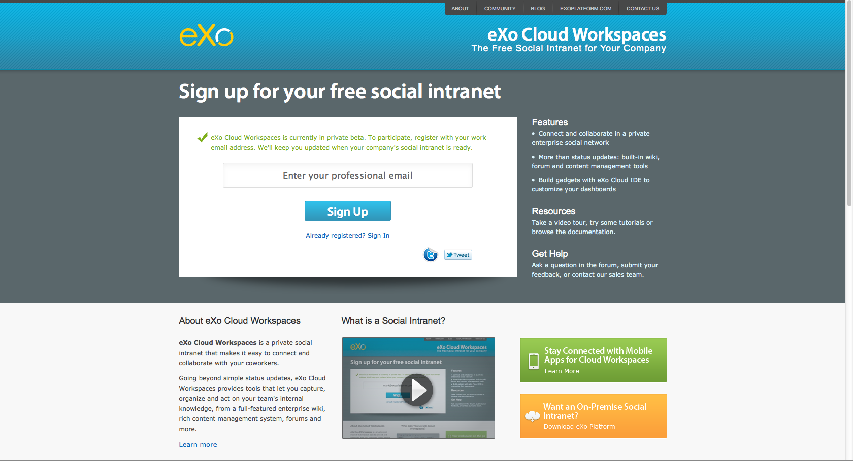
eXo Cloud Workspaces
Notes:
30

Slide 31
eXo Cloud Workspaces
Private enterprise social network in the cloud
www.cloud-workspaces.com
Currently in private beta
Personalized dashboards: your online work environment
Access and interact with colleagues and content in real-time
Drag-and drop gadgets into dashboards
Connect and collaborate in group workspaces
Share resources, ideas and feedback
Follow latest updates in activity streams
Use out the box or build custom extensions
Developers can integrate custom apps with embedded IDE
Notes:
eXo Cloud Workspaces lets you go beyond the basic chatter of activity streams, giving employees the tools to customize their working environment. Individual users can create personalized dashboards to act as the starting point for all their online work, while teams and projects can have their own dedicated workspace to connect, share resources and collaborate. Finally, developers can build and deploy custom apps with the embedded web-based IDE.

Slide 32
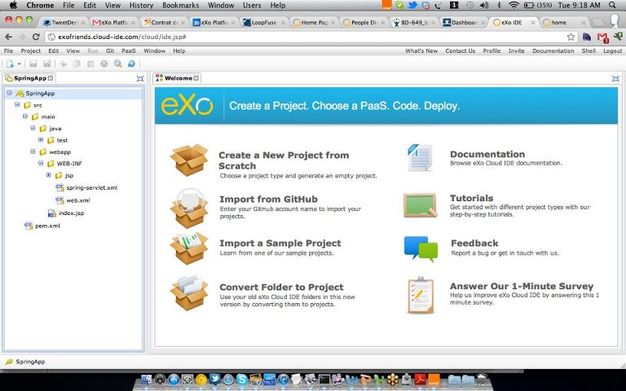
eXo Cloud IDE
Notes:
32

Slide 33
eXo Cloud IDE
Hosted Development-as-a-Service
www.cloud-ide.com
A complete desktop IDE in the cloud; no loss of ergonomics or performance
Collaborative Development
Develop REST services, gadgets, HTML5 and content apps
Multi-language, multi-framework; focus on Java & Spring but also supporting PHP, Ruby, Groovy, GWT and more
PaaS Deployment
PaaS deployment via Git push and/or WAR deployment
Support for: CloudBees, Heroku, Red Hat OpenShift, Cloud Foundry
Native Git integration; built-in command menu

Slide 34
Customer
Success Stories

Slide 35

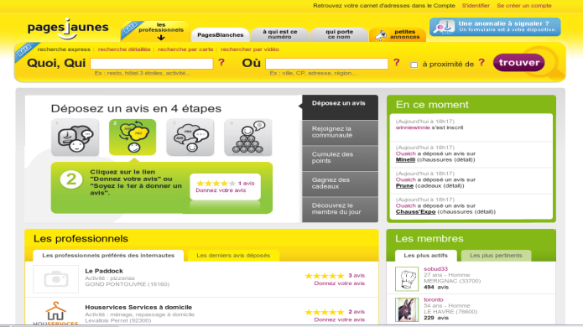
Pages Jaunes - Publishing
Company
France's leading business website developer & publisher of printed and online directories (Yellow Pages)
6th largest worldwide internet advertising revenue platform (500 Million Euros in 2009)
Requirements
Back office portal to manage:
Content (pushed on Apache server when published)
Applications (for customers/partners/users) as portlets
Competition
Liferay + OpenCMS
Partner
Groupe Open (SI)
Why eXo?
Single platform for content & apps
Standard-based (JCR, portlets, gadgets, xCMIS…)

Slide 36

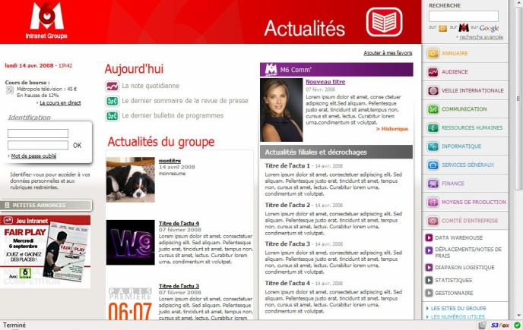
M6 – TV Media
Company
France-based audiovisual company specializing in the production, distribution and marketing of television programs
2009 revenue of 1.4 Billion Euros
Requirements
Create the next generation of M6 intranet
Offer a true collaboration platform for 3,000 users to share and exchange
Competition
EMC Documentum + BEA Weblogic
Partner
Business&Decision
Why eXo?
Flexibility to easily customize and add features
Lower cost and higher ROI

Slide 37

Generali - Insurance
Company
European leader in insurance sector
Generali France = 14 Billion Euros revenue
Requirements
Update homegrown sales management extranet without losing legacy content
Competition
IBM WebSphere
Partner
Bull France (provides L1 support)
Why eXo?
Broad support of standards and technologies
Ability to reuse existing content and deploy a new extranet for the sales team in only a few months

Slide 38
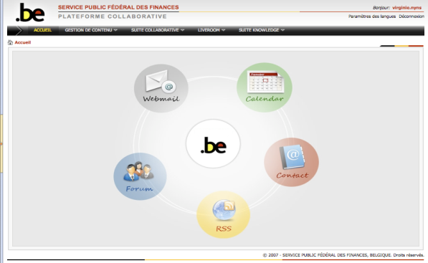
Belgium Ministry of Finance - Public
Organization
Ministry of Finance needed to eliminate information silos with departments using many different software solutions (SharePoint, FileNet…)
Requirements
Build a centralized system for collaboration that could be managed by its own IT department
Standardize on a rich portal platform with collaboration tools to connect up to 30,000 intended users
Competition
Bid process with many large software vendors
Partner
Bull Belgium (SI, Support and Dev.)
Why eXo?
Improved productivity, communication and knowledge sharing
Integrated email, calendaring, document management, and contact management solution

Slide 39
Our Business Model
Subscriptions & Professional Services

Slide 40
Subscription Benefits
Certified Production-Ready Software
Multi-year support and update policies
Includes features not available in community project
Access to all supported versions
Documentation & Knowledge Base
Maintenance Program
Delivering certified updates, patches and bug fixes
Access and support for new versions released
Enterprise Class Support
Unlimited incidents
Coverage up to 24*7 with 1 hour response time‏

Slide 41
eXo Platform 3.5 Professional
 | STANDARD | PREMIUM
Certified production-ready software
Maintenance program
New versions released during the subscription lifetime
Enterprise support | Business Hours | 24/7
Documentation & knowledge base
Pricing starts at: | 20 500 € | 28 000€

Slide 42
eXo Platform 3.5 Express
 | STANDARD | PREMIUM
Certified production-ready software
Maintenance program
New versions released during the subscription lifetime
Enterprise support | Business Hours | 24/7
Documentation & knowledge base
Pricing starts at: | 16 500 € | 23 000€

Slide 43
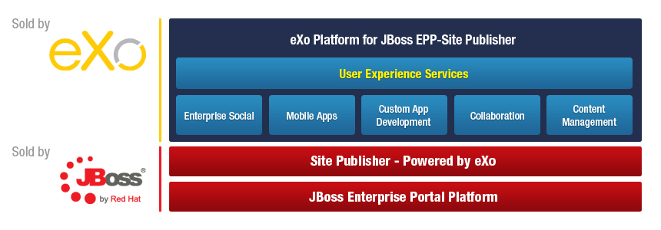
eXo Platform for JBoss

Slide 44
eXo Developer Subscription
 | STANDARD | PREMIUM
Access to eXo Platform | Up to 5 developers | Up to 10 developers
Developer support services | 20 cases | 50 cases
Developer documentation and knowledge base
Response time | 2 business Days | 1 business Day
Maintenance program
Dedicated contact within eXo
Pricing starts at: | 7 500 € | 18 500€

Slide 45
eXo TAM Subscription
 | TECHNICAL ACCOUNT MANAGER*
Designated contact within eXo support team
Proactive support
Onsite visits | 4 / year
Response time | Business Hours
Unlimited tickets
Pricing | Upon request
* An active eXo Platform subscription is required

Slide 46
eXo Professional Services
Evaluation Programs
Quick Start Program
Development Subscription
Training
Curriculum designed for admins, developers & architects
Certification
Consulting
POCs
Custom solutions
Migration
Notes:
46

Slide 47
Quick Start Program
Access to eXo Software portfolio | 3 months License
Developer Support Services | 10 cases
Developer documentation and Knowledge base
Response Time | 2 business Days
Maintenance Program
Dedicated eXo Training | 4 hours Webinar training
3 900€
* The entire program fee will be deducted from the purchase of an annual subscription

Slide 48
eXo Training & Certification
 | eXo FUNDAMENTALS (2 DAYS) | eXo DEVELOPER (3 DAYS) | eXo ARCHITECT (2 DAYS)
Course Objectives | Introduce the key benefits and features of eXo products | Customize eXo to support POCs & deployments | Manage, support & maintain eXo in production
Student Profile | Users, consultants, project managers, portal administrators, webmasters | System engineers with >1 year Java experience | System engineers with >4 years of Java experience
Prerequisite | - | eXo Fundamentals | eXo Developer
Public | 1,500.00 € | 1,900.00 € | 1,900.00 €
On-site, up to 8 participants | 5,000.00 € (plus T&L) | 6,500.00 € (plus T&L) | 6,500.00 € (plus T&L)
Notes:
48

Slide 49
eXo SI Partner Program
Benefit Highlights | SILVER | GOLD | PLATINUM
SUPPORT
Named support contacts | 4 | 5 | 8
Support services (number of cases) | 15 | 20 | 30
Support SLA (business days) | 2 days | 1 day | 1 day
TRAINING & CERTIFICATION (# seats included)
eXo Fundamentals / Developer / Architect | 4 / 3 / - | 6 / 3 / 2 | 8 / 4 / 3
Marketing & Sales Benefits
Visibility on eXo website, featured in email marketing campaigns; co-branded collateral; event participation; joint PR | Yes | Yes | Yes
Enterprise Subscription reseller & 1st line support royalty | Contact Us | Contact Us | Contact Us
Pre-sales support & sales enablement training | Yes | Yes | Yes
Lead sharing programs; program renewal discount | Yes | Yes | Yes
Partner Requirements
Partner Program contract terms; keep minimum number of eXo-certified resources; complete online certification annually
MARKETING BENEFITS
Joint marketing: webinar | - | - | Yes | Yes
Early product roadmap review with eXo | - | - | Yes | Yes
SALES BENEFITS
Enterprise Subscription reseller & 1st line support royalty | Contact Us | Contact Us | Contact Us | Contact Us
PARTNER REQUIREMENTS
Agree to eXo Partner Program contract terms and conditions | Yes | Yes | Yes | Yes
Provide level 1 support | Yes | Yes | Yes | Yes
KEEP A MINIMUM NUMBER OF TRAINED & eXo-CERTIFIED RESOURCES
...... eXo Fundamentals | 1 | 3 | 3 | 5
...... eXo Developer | 1 | 1 | 2 | 3
...... eXo Architect | - | - | 1 | 2
Successfully complete annual online certification exam | Yes | Yes | Yes | Yes
Notes:
Everything you need to get started quickly and deliver high-value projects to your customers:
Developer subscription & support
Training & Certification included
Royalties & Lead program
Sales & Technical support

Slide 50
eXo Reseller Program
BENEFIT Highlights | Authorized | Premier
SUPPORT
Named support contacts | - | 1
Support services | - | 5 cases
Support SLA | - | 2 business days
eXo Fundamentals Training & Certification courses (# seats) | - | 1
Discount on eXo Training & Certification courses | 7% | 10%
MARKETING & SALES BENEFITS
Visibility: eXo website; co-branded collateral; event participation | Yes | Yes
Communication: joint PR, visibility in eXo newsletter | Yes | Yes
Sales enablement training & pre-sales support | Opportunity-based | Yes
Events: co-exhibiting & sponsorship opportunities | - | Yes
Email marketing: promotion as Featured Partner in eXo newsletter | - | Yes
Promotion: joint press release | - | Yes
Sales Benefits
Royalties for Enterprise Subscription opportunities | Contact Us | Contact Us
Pre-sales: support from eXo resources | Opportunity based | Yes
Sales enablement: training for partner sales teams | - | Yes (Webinar)
Dedicated eXo sales & pre-sales contact | - | Yes
Partner Requirements
Agree and respect eXo Partner Program contract terms and conditions | Yes | Yes
Program subscription fee | Free | Contact Us

Slide 51
Thank You
Questions?
Contact us: sales@exoplatform.com

Slide 52
Backup Slides
Features & Screenshots

Slide 53
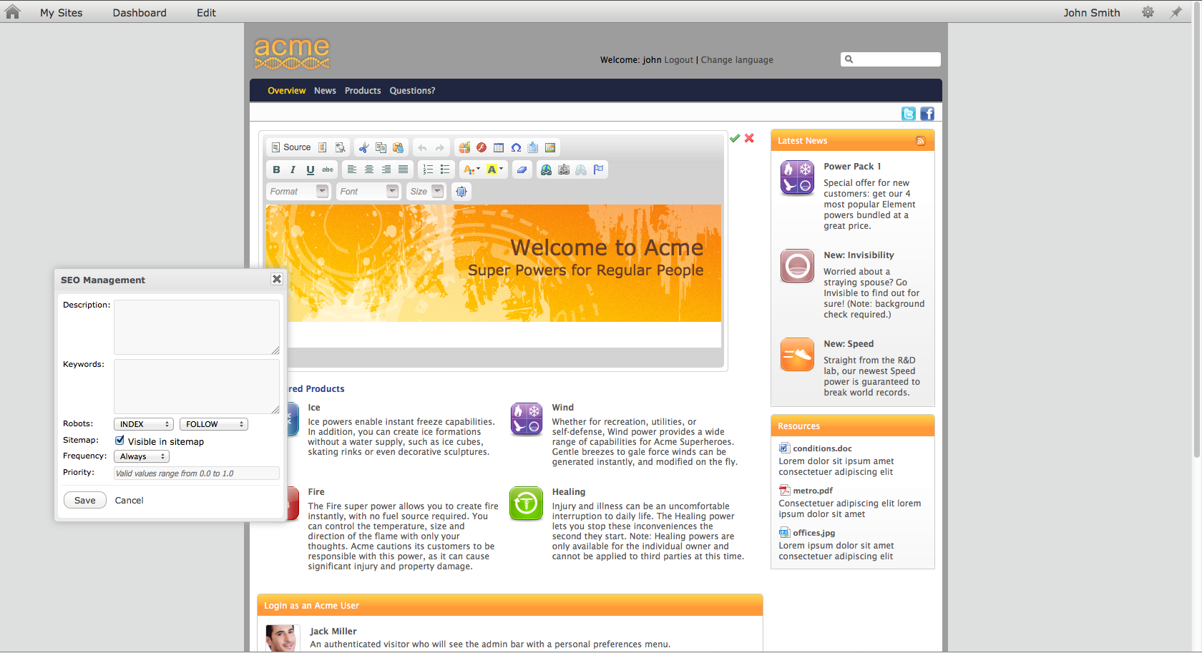
UXP Features: Content Management
Confidential – Internal Use Only
Notes:
53
ECM Features:
Create, edit & publish web content
Capture, store and manage documents
Optional BPM and workflow features
WCM Improvements for 3.5:
Edit inline (on the front-end) and publish in one click
SEO: Search Engine Optimization
New File Explorer Design

Slide 54
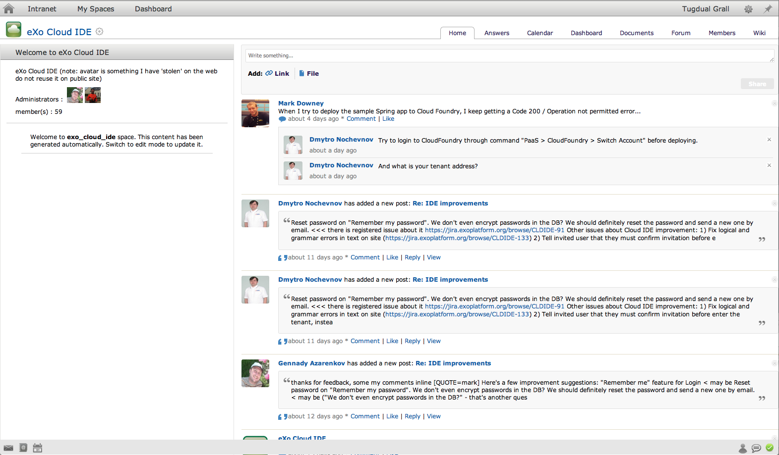
Enterprise Social Networks
Confidential – Internal Use Only
Notes:
54
Features/benefits:
Create and connect rich user and team profiles
Follow activity streams of users, teams, applications, processes
Workspaces for users and groups
OpenSocial gadgets
PLF 3.5 improvements:
New Activity Stream Page with Filters
User Directory is simplified
New Space Layout

Slide 55
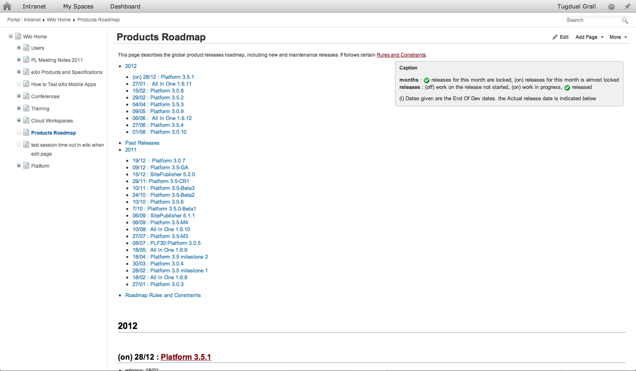
Knowledge Management: Wiki & Forum
Confidential – Internal Use Only
Notes:
55
An intranet or extranet that aims to connect a community of users, partners or customers will likely require a forum and/or wiki. eXo Platform 3.5 includes out-of-the-box features to easily add an enterprise wiki, forum, FAQ’s, and Answers to your sites.
Enterprise Wiki
Permissions integrated with eXo Platform user management
Social Network Integration ( Activity Stream, Space, …)
Pages are stored inside eXo JCR – our centralized content repository
Page Management, search & versionning
Easily add pages: Wysiwyg editor & support for multiple syntaxes
Forums, FAQs, Answers

Slide 56
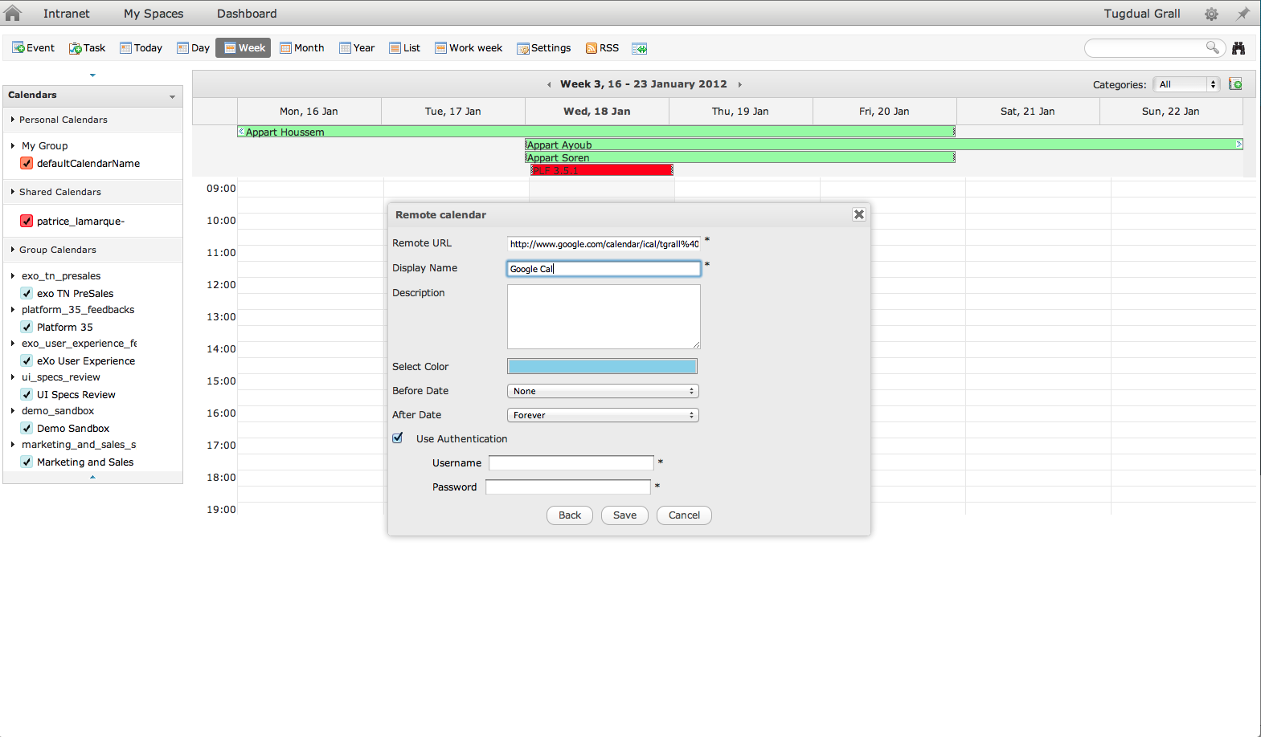
Collaborative Calendars
Confidential – Internal Use Only
Notes:
56
Calendars can be shared between users and teams
Improvements to PLF 3.5: Remote Calendar
Integrate 3rd Party Calendar into eXo Calendar
Based on Standard CalDAV, Ical
Apps: Google Calendar, MS Exchange, …
Warning: Read Only
You can view all your calendars in eXo but cannot update them

Slide 57
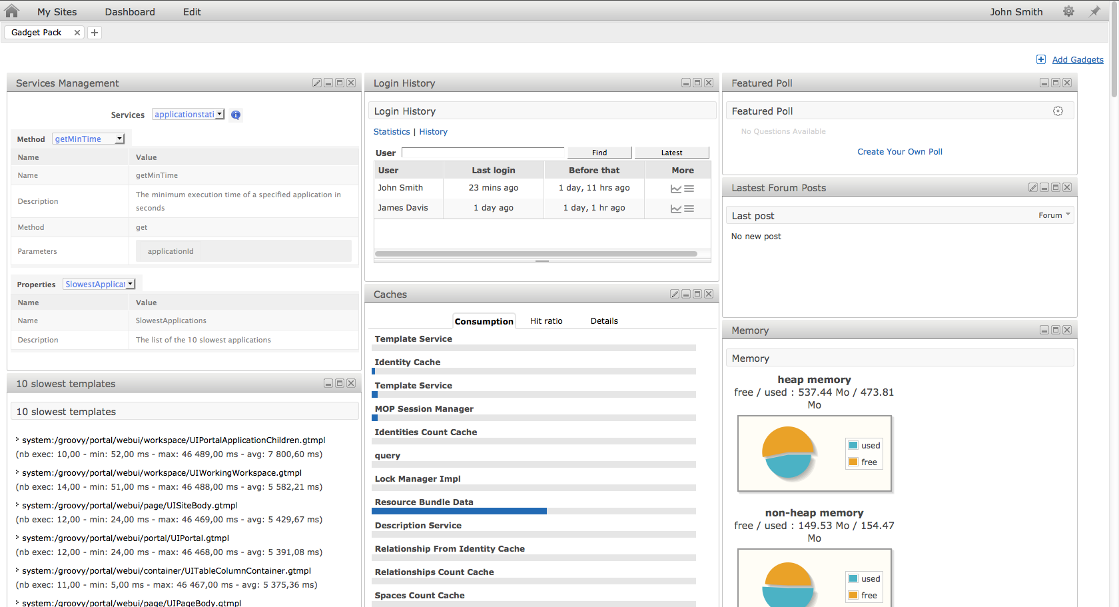
Extensible: Gadget Pack
Confidential – Internal Use Only
Notes:
57
Drag and drop gadgets to create personalized dashboards

Slide 58
Extensible: Gadget Pack
Gadget Pack for eXo Platform 3.5 Enterprise Edition
Developers can quickly learn eXo APIs to build new functionality for end users
Engagement Gadgets
Latest Forum Posts
Top Voted Topics
Forum Statistics
Who’s Online?
Latest Wiki Updates
Friend Suggestions
Featured Poll
Audit Gadgets
User Login History
Page Activity Stats
User Activity Audit
Collaboration Gadgets
Calendar
Publish Content
Text Translation
Management & Monitoring Gadgets
Memory Charts
Cache Levels
Applications Statistics
10 Slowest Templates
All Template Statistics
Services Management
Groovy Console
Notes:
58

Slide 59
Why a Web IDE?
A complete desktop IDE, now in the cloud
No loss of ergonomics or performance
Mashup development
Wiring REST Services, Gadgets, HTML5 and structured content
Quick test in IDE with no deployment overhead
Collaborative editor
Social coding
Wiki and forum integration
Centralized administration
No setup, available on all computers
Simple upgrades

Slide 60
How to Reach Us
Technical & product information
Video demos, tutorials, webinars and more: eXo Resource Center
Technical questions:
eXo Support (for eXo Platform Subscription customers)
eXo Forum
Pricing information, help with an RFI or PoC: eXo Sales team

Slide 61
COMMUNITY VS ENTERPRISE
eXo COMMUNITY PROJECTS Use eXo community projects if you are ready to: | eXo PLATFORM 3 With eXo Platform, you get:
Resolve issues and bugs during development. Perform integration, packaging and compatibility testing of the different community editions. Rely on the community for answers to questions. Identify and resolve security issues on your own. Support the software in production on your own without any SLA. Do not require additional features such as eXo Development Tools, which are available only in eXo Platform 3. | Enterprise-quality support during development and/or production with guaranteed SLAs. An integrated package, tested and certified on multiple JVMs and Operating Systems. Additional functionality, including eXo Development Tools & eXo Cloud Continuous updates and patches to resolve security, performance, and stability issues. Notifications about security issues and advice on how to resolve them.
Notes:
61

